Slide 1
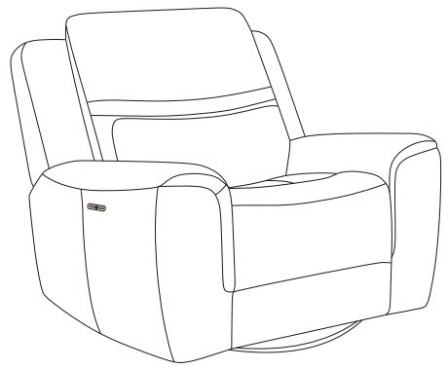
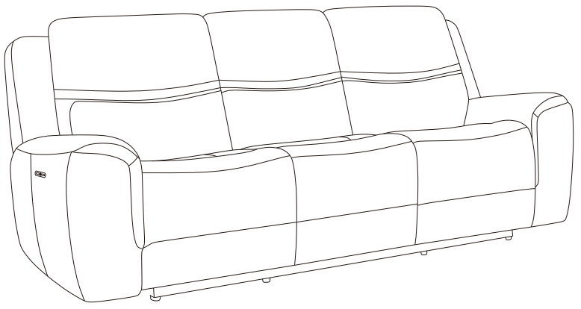
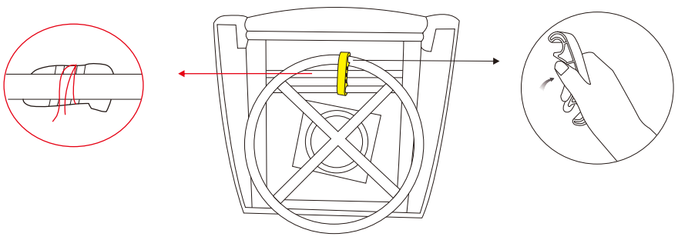
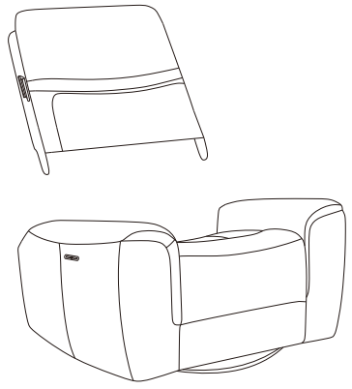
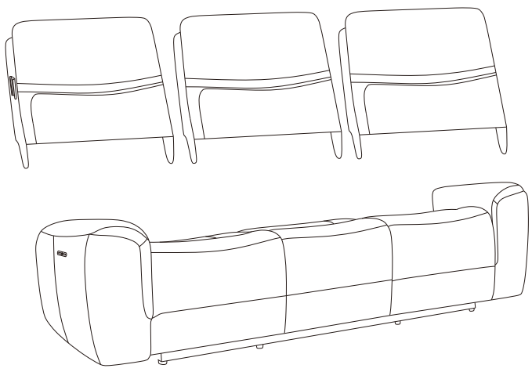
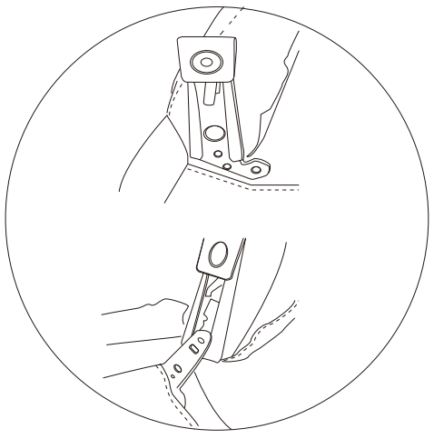
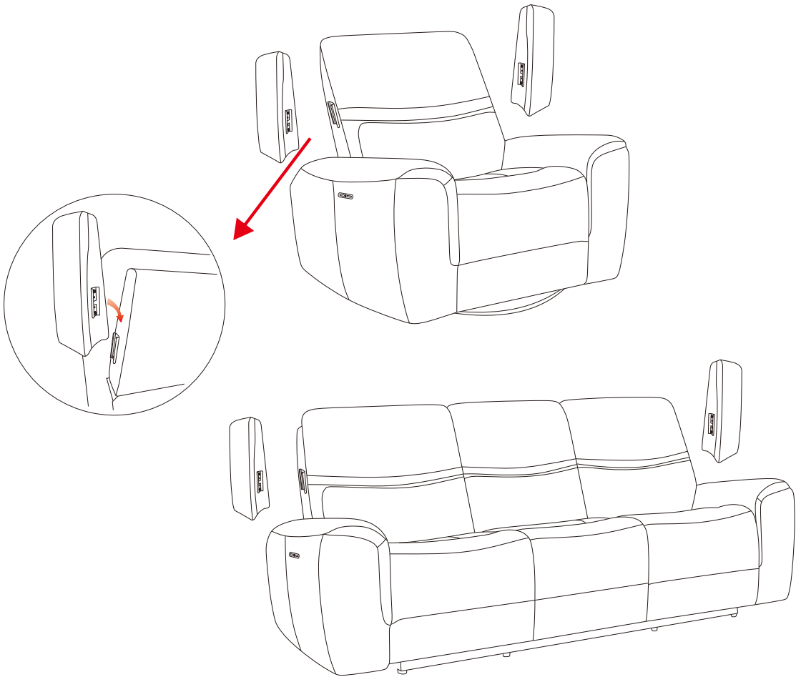
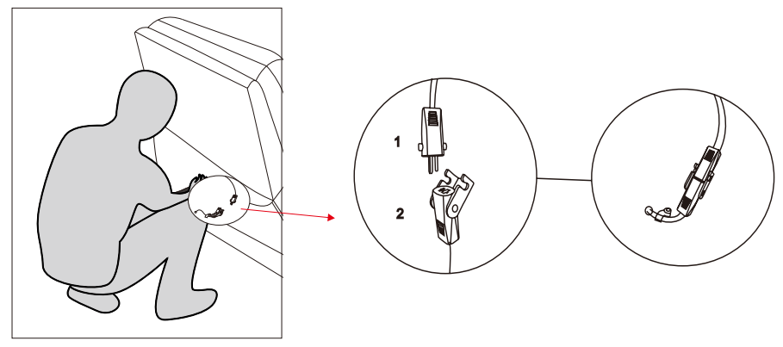
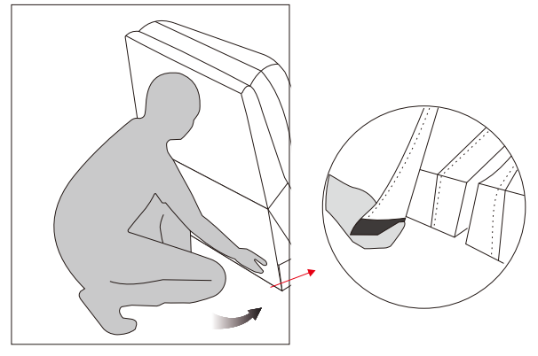
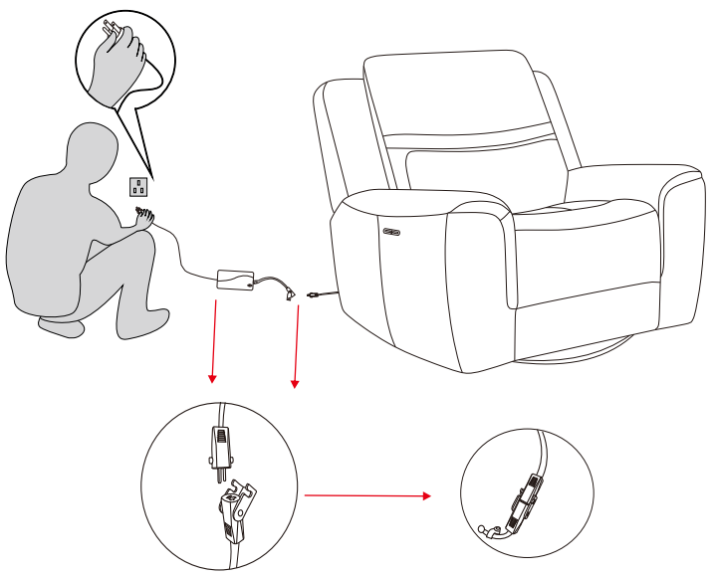
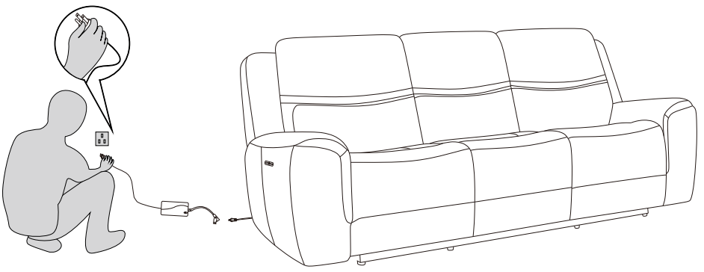
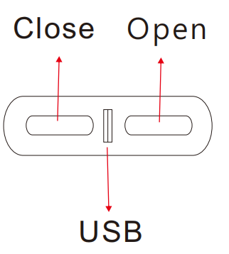
Assembly Instruction
Item Code-Connor (KM.329B)
Imported By JCI Global
Building 3 west,605 Zillmere Rd.Aspley QLD 4035
BEFORE YOU START...
1. Chose a clean jevel spacious assembly area.Avoid hard surface that may damage the product.
2. Check and ensure that you have all required contents for complete assembly.
3. Always read the assembly instructions carefully before beginning assembly.
4. The packaging and contents can be a choking hazard, therefore keep out of reach of small children at all the times
Step 1 Turn to the bottom of the sofa. Take out the accessory
Step 2 Insert the backrest into the sofa as shown in the picture
Step 3 Connect the backrest to the seat cushion as shown
Step 4 Connect as picture shown

