Slide 1
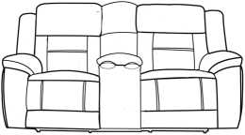
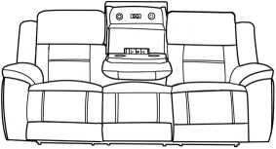
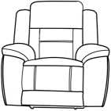
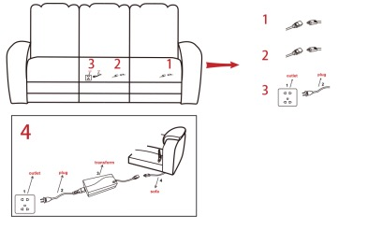
Assembly Instruction
Item Code-Venus (7882)
Imported By JCI Global
Building 3 west,605 Zillmere Rd,Aspley QLD 4035
BEFORE YOU START...
1 .Chose a clean, level, spacious assembly area. Avoid hard surface that may damage the product.
2. Check and ensure that you have all required contents for complete assembly.
3. Always read the assembly instructions carefully before beginning assembly.
4. The packaging and contents can be a choking hazard, therefor keep out of reach of small children at all the times.
Step 1 Join sofa by back connector
Open the carton, take out the bag from the none-woven bag, connect the back to seat as below:
Step 2 Wire connection
1 )LED Light Wire connection, Open the back flag of LHF seat, Connect the parts as instructed
2) Reading Lamp wire connection, Open the back flag of Middle seat, Connect the parts as instructed
3) Make the USB Charger work: Open the back flag of Middle seat, connect the plug to the wall or any other places as instructed
4) Take out the electric parts from the bottom of the sofa, assemble them as right instruction, connect the line under recliner to the transformer directly.

Slide 2
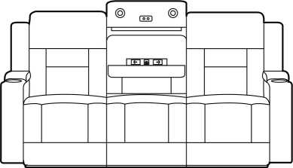
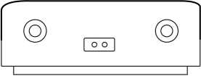
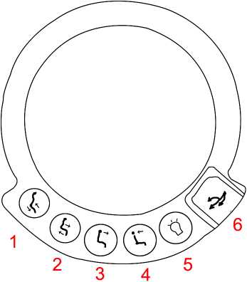
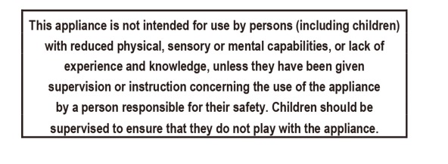
Function 1: Socket outlet for the E-station
Press the Button to open the Socket outlet for the E-station.
Function 2: Reading Lamp
Touch the button to control the luminance, all 3 grades
Function 3: Cupholder Instruction
1) Recline
2) Back to sitting position
3) Close the headrest
4) Open the headrest
5) Light
6) USB Charger

